Slide 1
Coupa Supplier Portal (CSP) Training

Slide 2
08
How to Submit Invoices

Slide 3
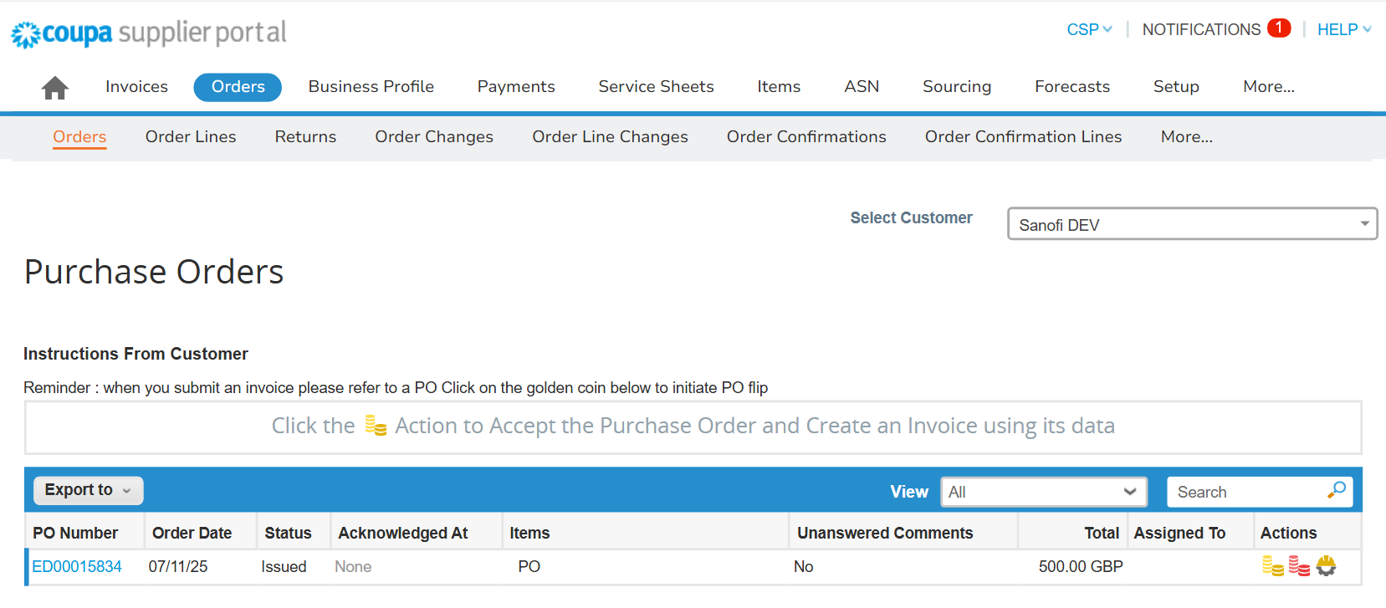
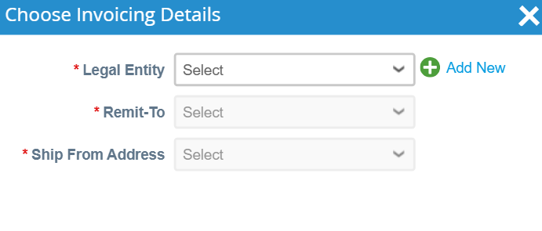
EXAMPLE
How to Submit Invoices (1/6)
1
How to Submit Invoices (1/6)
To flip a PO into an invoice, login to your CSP account:
Select the “Orders” tab
Under the “Orders” sub-tab, use the search bar to search for the PO
If you are unable to see your purchase order, make sure you have selected the correct customer from the “Select Customer” drop-down in the top right-hand corner
Click on the yellow coins icon to create an invoice
If this is your first time creating an invoice, a pop-up screen will prompt you to select a “Legal Entity”, “Remit-To”, and “Ship-From Address”
3
2
4
5
Note: If you are providing a discount, please navigate to “How to Submit Invoices with Discounts” section; if you are correcting unit price, please navigate to “How to Correct Invoices” section.

Slide 4
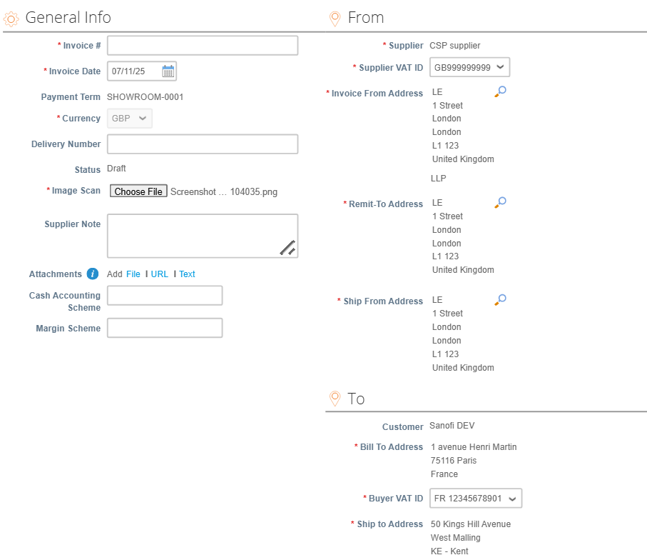
EXAMPLE
How to Submit Invoices (2/6)
5
How to Submit Invoices (2/6)
On the invoice creation page :
Complete the mandatory fields in the “General Info”, “From”, and “To” sections*
In “From” section, if you want to change the “Invoice From Address”, “Remit-To Address”, or “Ship From Address”, click the magnifying glass icon to select the respective addresses
6
*Note: the “From” section will pre-populate based on the information on your CSP account and the “To” section pre-populates based on the information on the Purchase Order.

Slide 5
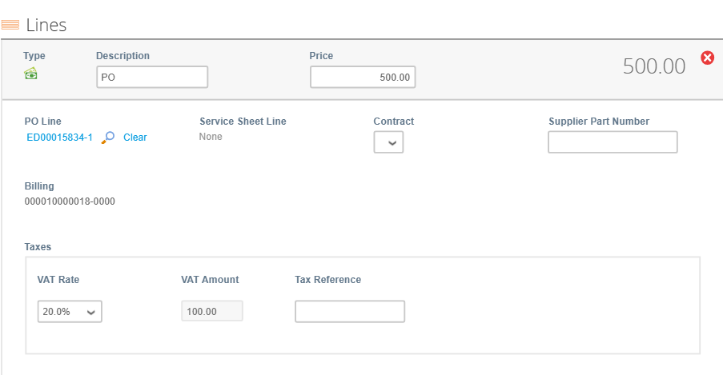
EXAMPLE
How to Submit Invoices (3/6)
7
9
How to Submit Invoices (3/6)
On the same page, scroll down to the “Lines” section, review the pre-populated fields and edit if needed.
For partial invoice, if the PO is:
Quantity-based (i.e. the “Category” is Goods), edit the “Qty” field
Amount-based (i.e. the “Category” is Services), edit the “Price” field
To delete lines, click on the “x” icon
8

Slide 6
EXAMPLE
How to Submit Invoices (4/6)
How to Submit Invoices (4/6)
In “Taxes” subsection, select or populate the tax rate for each line item if applicable (depending on the country, the “Taxes” subsection may be different and have different required fields.)*
It is important to ensure the tax details you populate in this subsection match with your tax records – e.g. you will need to select or populate the correct tax rate in terms of the goods/services supplied
10
*Note: Multiple taxes are applicable for Canada, India, Mexico and Brazil only. All other countries cannot add multiple tax lines on the invoices.

Slide 7
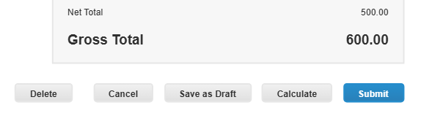
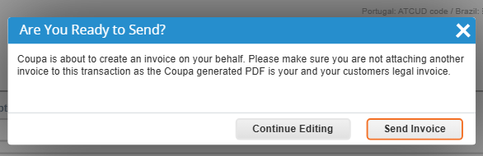
EXAMPLE
How to Submit Invoices (5/6)
How to Submit Invoices (5/6)
On the same page, scroll down to the summary section here there are actionable buttons:
Click on the “Save as draft” button to save the invoice for later
Click on the “Calculate” button to refresh the price calculation
Click on the “Submit” button to submit the invoice
After clicking the “Submit” button, a pop-up confirmation window will appear – click on the “Send Invoice” button when ready*
11
12
*Note: Coupa will create a legal invoice on your behalf so you do not need to attach one.

Slide 8
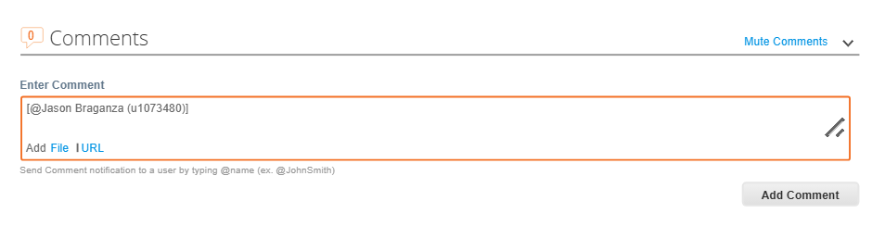
EXAMPLE
How to Submit Invoices (6/6)
13
How to Submit Invoices (6/6)
To add comments on the invoice, scroll down and use the “Comments” section on the Invoice creation page:
13a. Populate your comments and click “Add Comment”, it will be directly sent to Sanofi requester
13b. Use the @name functionality to send comments to additional Sanofi users*
13b
13a
*Note: Once the response from Sanofi is available, you will receive a notification and will be able to see responses in this section.

Slide 9
09
How to Submit Credit Notes

Slide 10
EXAMPLE
How to Submit Credit Notes (1/6)
1
How to Submit Credit Notes (1/6)
To flip a PO into a Credit Note, login to your CSP account:
Select the “Orders” tab
Under the “Orders” sub-tab, use the search bar to search for the PO
Click on the red coins icon to create a credit note
2
3
Note: Credit note creation is also applicable for providing discount and correcting unit price. Please navigate to “How to Submit Invoices with Discounts” OR “How to Correct Invoices” section for detailed steps.

Slide 11
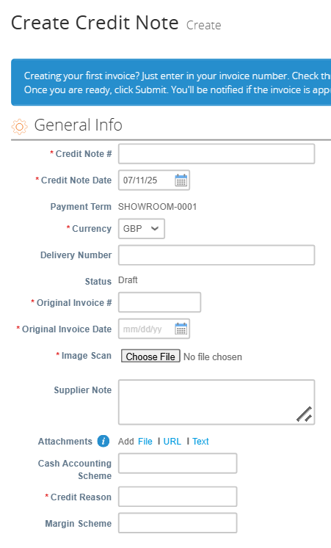
EXAMPLE
How to Submit Credit Notes (2/6)
How to Submit Credit Notes (2/6)
On the create credit note page:
Complete the required fields in the “General Info” section
4

Slide 12
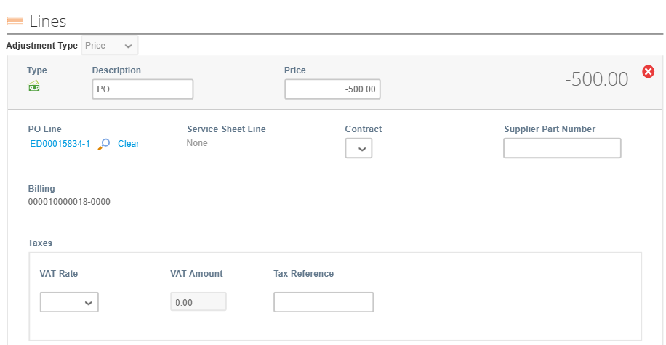
EXAMPLE
How to Submit Credit Notes (3/6)
How to Submit Credit Notes (3/6)
On the same page, scroll down to the “Lines” section:
Ensure the value in the “Price” or “Qty” field is negative, if the PO is:
Quantity-based (i.e. the “Category” is Goods), edit the “Qty” field;
Amount-based (i.e. the “Category” is Services), edit the “Price” field.
To delete lines, click on the “x” icon.
5
6

Slide 13
EXAMPLE
How to Submit Credit Notes (4/6)
How to Submit Credit Notes (4/6)
In the “Lines” section and “Taxes” subsection:
Select or populate the tax rate for each line item if applicable (depending on the country, the “Taxes” subsection may be different and have different required fields.)*
It is important to ensure the tax details you populate in this subsection match with your tax records – e.g. you will need to select or populate the correct tax rate in terms of the goods/services supplied.
7
*Note: Multiple taxes are applicable for Canada, India, Mexico and Brazil only. All other countries cannot add multiple tax lines on the invoices.

Slide 14
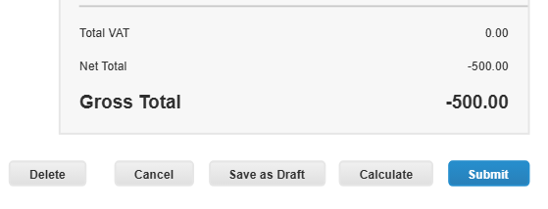
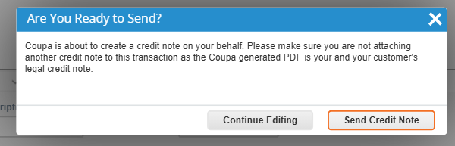
EXAMPLE
How to Submit Credit Notes (5/6)
How to Submit Credit Notes (5/6)
On the same page, scroll down to the summary section here there are actionable buttons:
Click on the “Save as draft” button to save the credit note for later
Click on the “Calculate” button to refresh the price calculation
Click on the “Submit” button to submit the credit note
After clicking the “Submit”, button a pop-up confirmation window will appear – click on the “Send Credit Note” button when ready*
8
9
*Note: Coupa will create a legal credit note on your behalf, so you do not need to attach one.

Slide 15
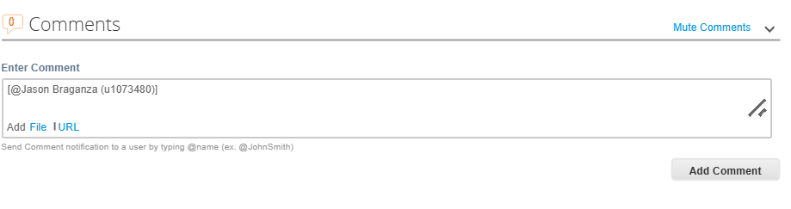
EXAMPLE
How to Submit Credit Notes (6/6)
10
How to Submit Credit Notes (6/6)
To add comments on the Credit Note, scroll down and use the “Comments” section on the Credit Note creation page:
10a. Populate your comments and click “Add Comment”, it will be directly sent to Sanofi requester
10b. Use the @name functionality to send comments to additional Sanofi users*
10b
10a
*Note: Once the response from Sanofi is available, you will receive a notification and will be able to see responses in this section.

Slide 16
10
How to View Invoices and Credit Notes

Slide 17
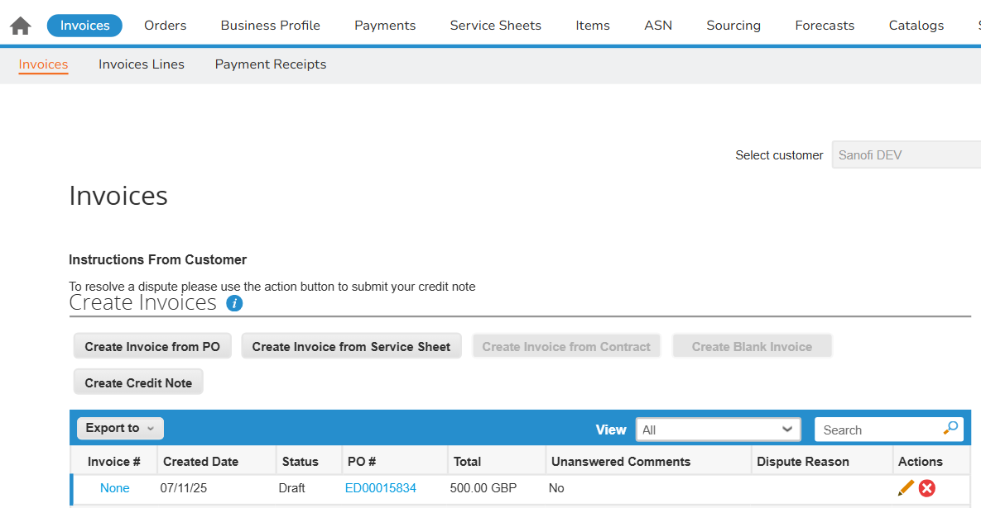
EXAMPLE
How to View Invoices and Credit Notes (1/2)
1
How to View Invoices and Credit Notes (1/2)
To view the general info of the invoice/credit note, login to your CSP account:
Select the “Invoices” or “Credit Note” tab
Under the, use the search bar to search for the invoice/credit note
To view invoices or credit notes with specific criteria, use the ‘Views’ dropdown menu to select an existing view or create your own custom view
You will see general info of the invoice/credit note, e.g. “Created Date” and “Status”*
3
2
4
Status | Definition
Approved | This status indicates the invoice/credit note has been accepted for payment by Sanofi.
Disputed | This status indicates the invoice/credit note has been disputed by Sanofi. You will need to review comments and action to resolve the dispute.
Draft | This status indicates the invoice/credit note is saved in draft and has not been submitted yet.
Invalid | This status is specific for compliant e-invoices for clearance countries. It indicates the compliant invoices submitted have incorrect or incomplete information and therefore have been moved to a permanent Invalid state.
Pending Approval | This status indicates the invoice/credit note is currently under review by Sanofi.
Processing | This status indicates the invoice/credit note is being processed by Sanofi’s Accounts Payable department.
*Note: The “Status” can be any of those cited in the table.

Slide 18
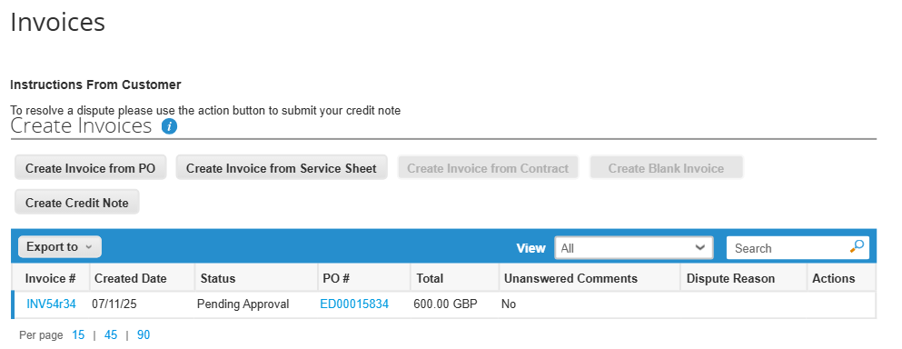
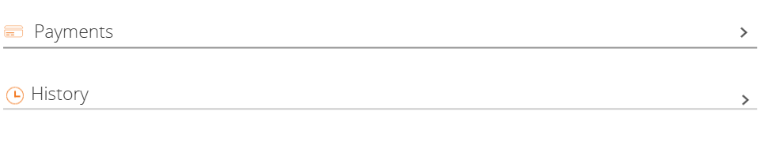
EXAMPLE
How to View Invoices and Credit Notes (2/2)
How to View Invoices and Credit Notes (2/2)
To view the payment details and the history of the invoice/credit note, click into to the invoice/credit note #
Scroll down to the bottom of the page:
Unfold the “Payments” section to view payment details
Unfold the “History” section to view the audit trail of all changes applied to the invoice/credit note
5
6

